Slide 1
COMPILER CONSTRUCTION CS F363
Introduction to Compilers and Phases
Dr. R. Elakkiya, AP/CS

Slide 2
Text Book
Aho, Lam, Sethi and Ullman, “Compilers-Principles, Techniques & Tools”, Pearson/Addison-Wesley, Second Edition, 2013.

Slide 3
Text Book Reading:
Chapter 1
Section 1.1, 1.2

Slide 4
Objectives
introducing the Lexical and Syntactic structure of a Language, the different phases of Compiler Design
understand and apply the principles of compiler design in the development of system software tools & applications

Slide 5
Overview
In this Lecture
Introduction
Language Preprocessors
Structure of Compiler
Phases of Compiler

Slide 6
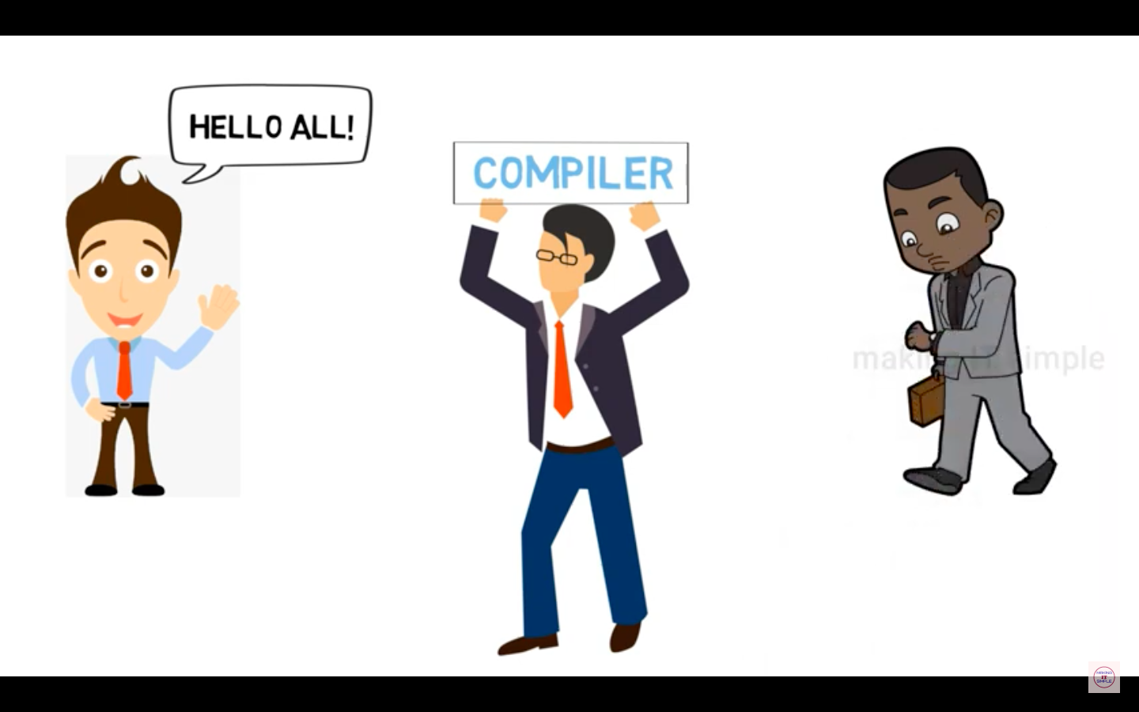
Introduction

Slide 7
Introduction

Slide 8
Introduction

Slide 9
Introduction

Slide 10
Introduction

Slide 11
Introduction

Slide 12
Introduction

Slide 13
Introduction

Slide 14
Introduction

Slide 15
Introduction

Slide 16
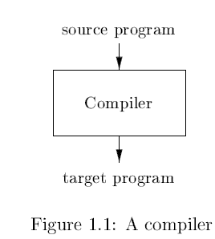
Introduction
What are Compilers?
System software (It is a program!)
Language processor
Translates source program into target program (i.e.) one representation/high level language program to another representation/low level language program

Slide 17
Introduction
Difference between compiler and interpreter
Interpreter
Does not generate target program
Execute the operations specified in the source program on inputs supplied by the user
Give better error diagnostics than a compiler
Slower than a compiler

Slide 18
Introduction
Source
Program
Interpreter
Output
Input
Error messages
Input
Source
Program
Compiler
Target
Program
Error messages
Output

Slide 19
Language Processors
Java combines compilation and interpretation

Slide 20
Language Processors
A language-processing system / program development environment
Assembly language
is easier to produce as output and is easier to debug
linker resolves
external memory addresses, where the code in one file may refer to a location
in another file

Slide 21
The Structure of a Compiler
Compiler has two parts
analysis part / front end
synthesis part / back end
Analysis part
breaks up the source program into constituent pieces
imposes a grammatical structure on them
create an intermediate representation
Provide error messages (syntax/semantics)
collects information about the source program and stores it in a data structure called a symbol table

Slide 22
The Structure of a Compiler
Synthesis part
Receives symbol table and intermediate representation from analysis part
Constructs the desired target program

Slide 23
Phases of a Compiler

Slide 24
Example
Position = initial + rate * 60
Generate the target machine code for the given expression

Slide 25
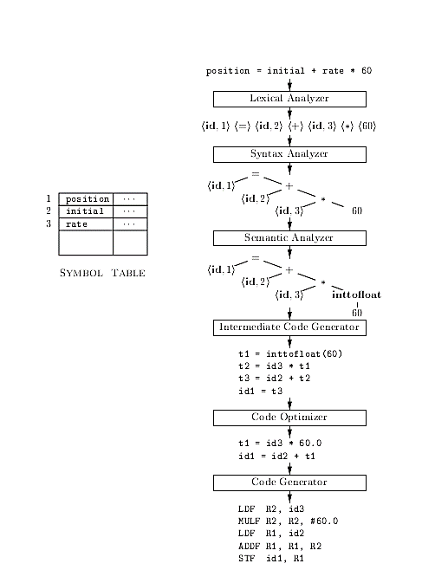
Phases of a Compiler
Figure 1.7: Translation of an assignment statement

Slide 26
Phases of a Compiler
Symbol-Table
The symbol table is a data structure containing a record for each identifier (variables, constants, functions) with fields for the attributes of the identifier
Attributes of variables are name, type, scope, etc.
Attributes of procedure names, may provide information about the number and types of its arguments, the method of passing each argument (for example, by value or by reference), and the type returned

Slide 27
Phases of a Compiler
Symbol-Table
Accessed in every phase of compiler
The scanner, parser, and semantic analyzer put names of identifiers in symbol table.
The semantic analyzer stores more information (e.g. types) in the table.
The intermediate code generator, code optimizer and code generator use information in symbol table to generate appropriate code.
Mostly use hash table for efficiency.

Slide 28
Phases of a Compiler
Grouping of Phases into Passes
A pass reads an input file process it and writes an output file
It can involve several phases
Normal passes in compilers
front-end phases are combined into a pass
code optimization is an optional pass
back-end phase can be made into a pass

Slide 29
Phases of a Compiler
Lexical Analysis/Scanning
Groups the characters of source program into meaningful sequences called lexeme
For each lexeme, the lexical analyzer produces as output a token
The token is passed on to syntax analysis phase
token-name is an abstract symbol
attribute-value points to an entry in the symbol table for this token (needed for semantic analysis and code generation)

Slide 30
Phases of a Compiler
Syntax analysis/parsing
Uses tokens produced by the lexical analyzer determines if the syntax (structure) of the program is correct according to the (context-free) grammar of the source language
Creates a tree-like intermediate representation (parse tree/syntax tree) that depicts the grammatical structure of the token stream
Syntax tree: Each interior node represents an operation and the children of the node represent the arguments of the operation. It shows the order of operations

Slide 31
Phases of a Compiler
Semantic analysis
Uses the syntax tree and the information in the symbol table to check the source program for semantic consistency with the language definition
Gathers type information and saves it in either the syntax tree or the symbol table
Type checking: each operator has matching operands eg. array index must be an integer

Slide 32
Phases of a Compiler
Semantic analysis
Some language specifications may allow type conversions called coercions
Eg. a binary arithmetic operator may be applied to either a pair of integers or to a pair of floating-point numbers. If the operator is applied to a floating-point number and an integer, the compiler may convert or coerce the integer into a floating-point number

Slide 33
Phases of a Compiler
Intermediate Code (IC) Generation
IC: low-level or machine-like intermediate representation
Takes a parse tree from the semantic analyzer and generates a program in the intermediate language
Properties of IC:
easy to produce
easy to translate into the target machine
Three-address code (TAC)
which consists of a sequence of assembly-like instructions with three operands per instruction
x = y op z
Postfix notation

Slide 34
Phases of a Compiler
Code Optimization
improve the intermediate code so that better (faster/use lesser resources like memory, space, registers and power) target code will result
Note: Optimization may consume time (eg. Optimizing compilers)
Code optimization can be done:
after intermediate code generation (M/C independent code optimization)
performed on a intermediate code
after code generation (M/C dependent code optimization)
performed on a target code

Slide 35
Phases of a Compiler
Error detection and reporting
Done at every phase if any error is identified it is reported and handled
Lexical error: Misspelling an identifier or keyword Eg. Fi (a == b) (fi can be and identifier, misspelled keyword or a function name. But lexical analysis considers it as identifier)
Syntax error: An arithmetic expression with unbalanced parenthesis
Semantic error: operator applied to incompatible operand types
Logical error: Infinite recursive call

Slide 36
Phases of a Compiler
Code Generation
Takes as input an intermediate representation of the source program
Produces the target language (machine code or assembly language code)
Choose registers and memory locations for the variables in the program

Slide 37
References
Material covers text book ch1 sections1.1and1.2

Slide 38
Summary
In this Lecture
Introduction
Language Preprocessors
Structure of Compiler
Phases of Compiler

Slide 39
Thank you

